Slide 1



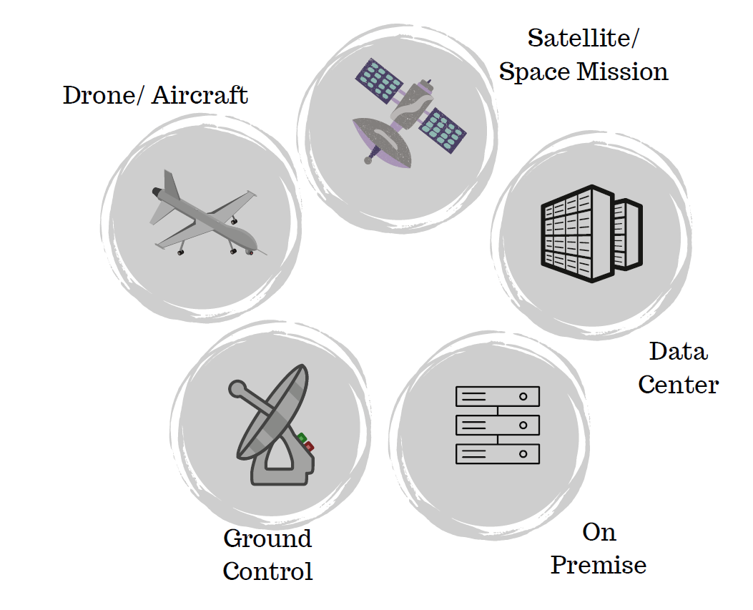
NSF-Crosstalk Phase I Updates
Mission and objectives:
Dual-use AI accelerator/Big data analytics chip design
Demonstrate proof-of-concept at 28nm
Develop a software interface to communicate with the chip
Benchmark against state-of-the-art for computer vision application (i.e., ResNet-50)
Recent Updates
NSF Phase I ended
Pending proposals and incubations

Slide 2
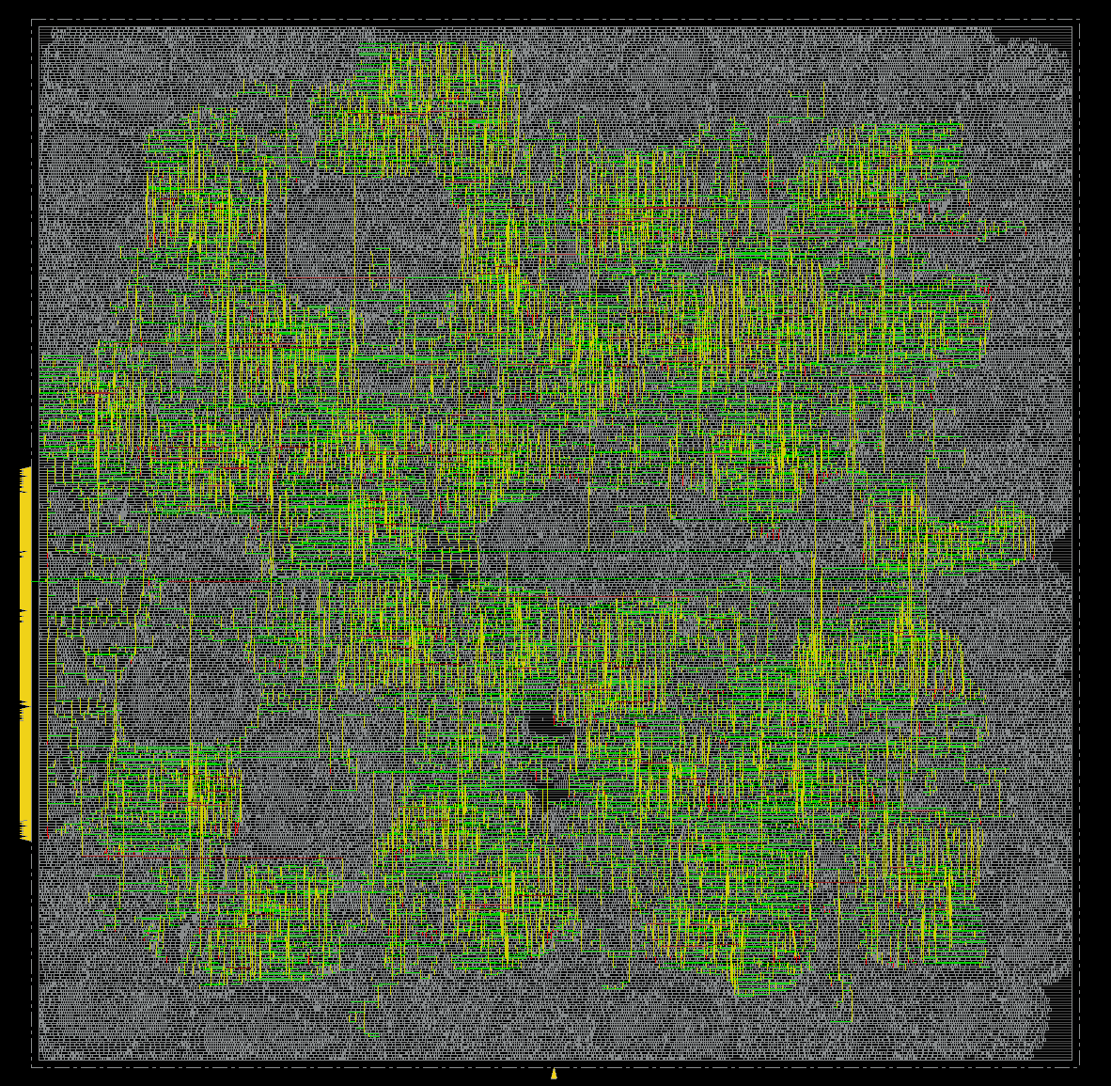
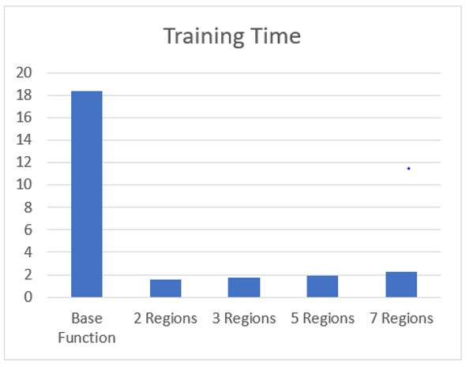
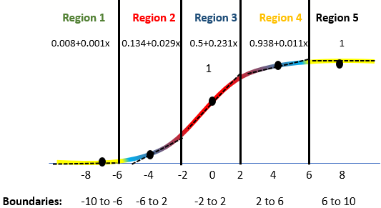
High-Level Overview of the Program:
Develop chip design flow to go from RTL to GDSII.
Optimization for Area, Power, and Performance.
Integrate embedded memory from TSMC.
Develop software interpreter to interface with Open-Source Compilers.
Explore commercialization opportunities.
NDA: Qualcomm, TactComputeLab, NAG, HP, InAccel

Slide 3
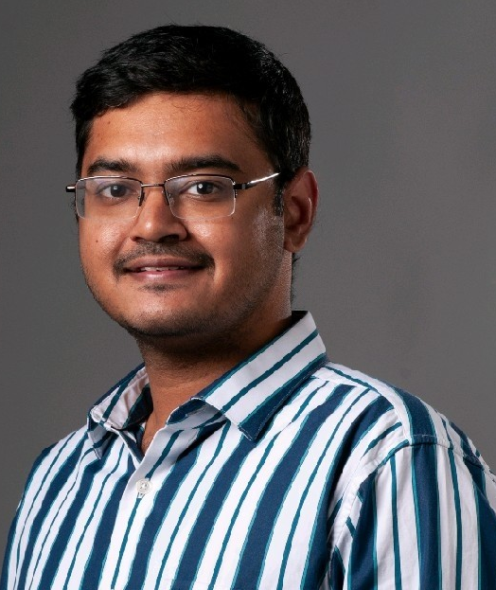

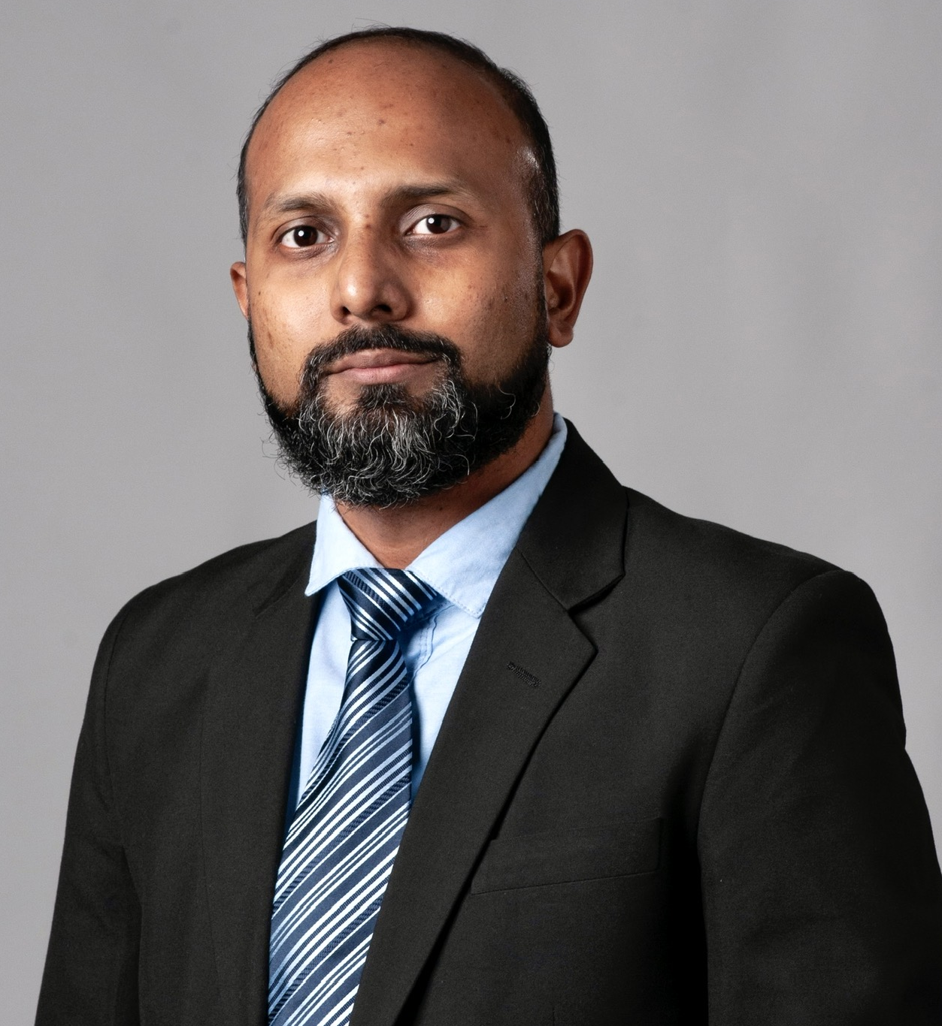
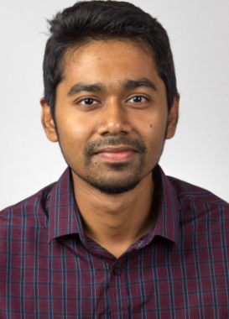
Program Summary
Sponsor: NSF
Funding: $256K
Number of staff/faculty/students:
Staff – 1
Faculty – 2
Students – 1
Major milestones remaining:
Finalize GDS II with optimized power and performance
Test the chip
Identify customers and commercialization pathway
Timeline for project: 01FEB21 – 31DEC22
Rahul Srinivas
(MIDE/ECE)
Kalyan Durbhakula
Asst. Res. Prof (MIDE)
Arif Iqbal
(Crosstalk/Arithmik)
Mostafizur Rahman
Asst. Prof (ECE)

